Slide 1


Slide 2
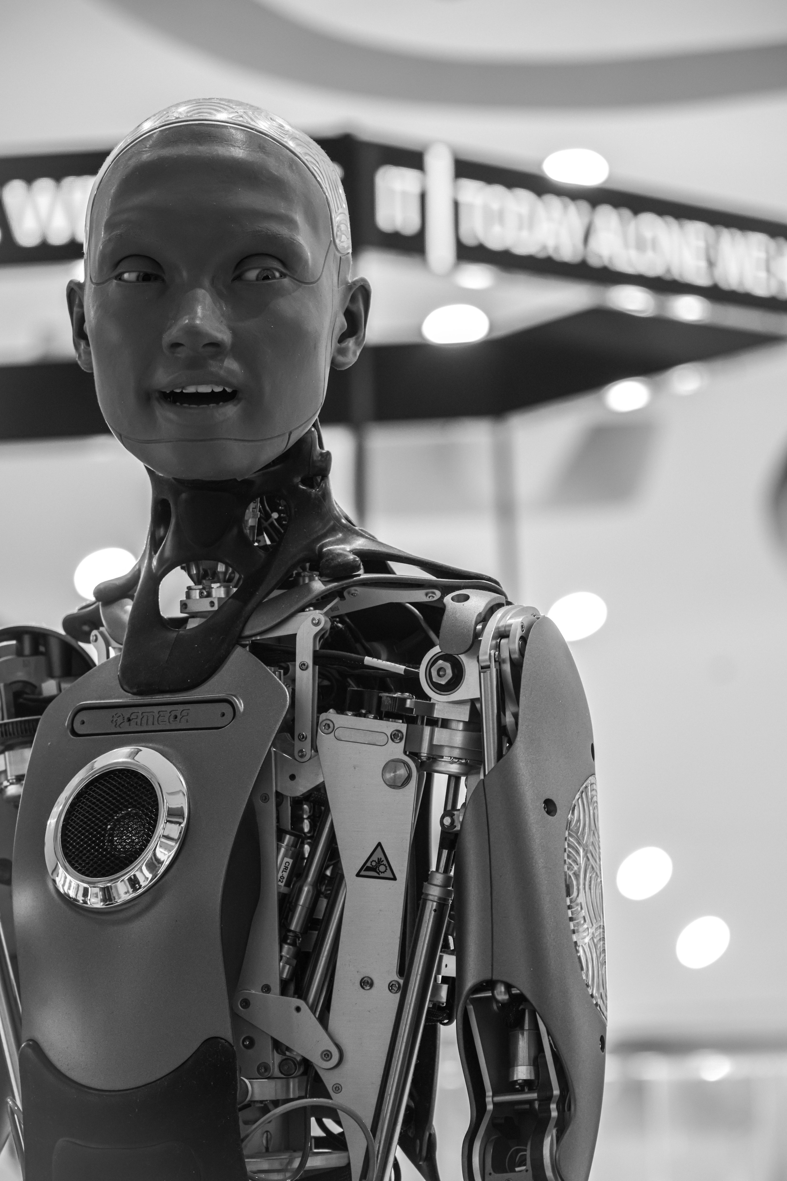

WELCOME
NSIT FAMILY

Slide 3
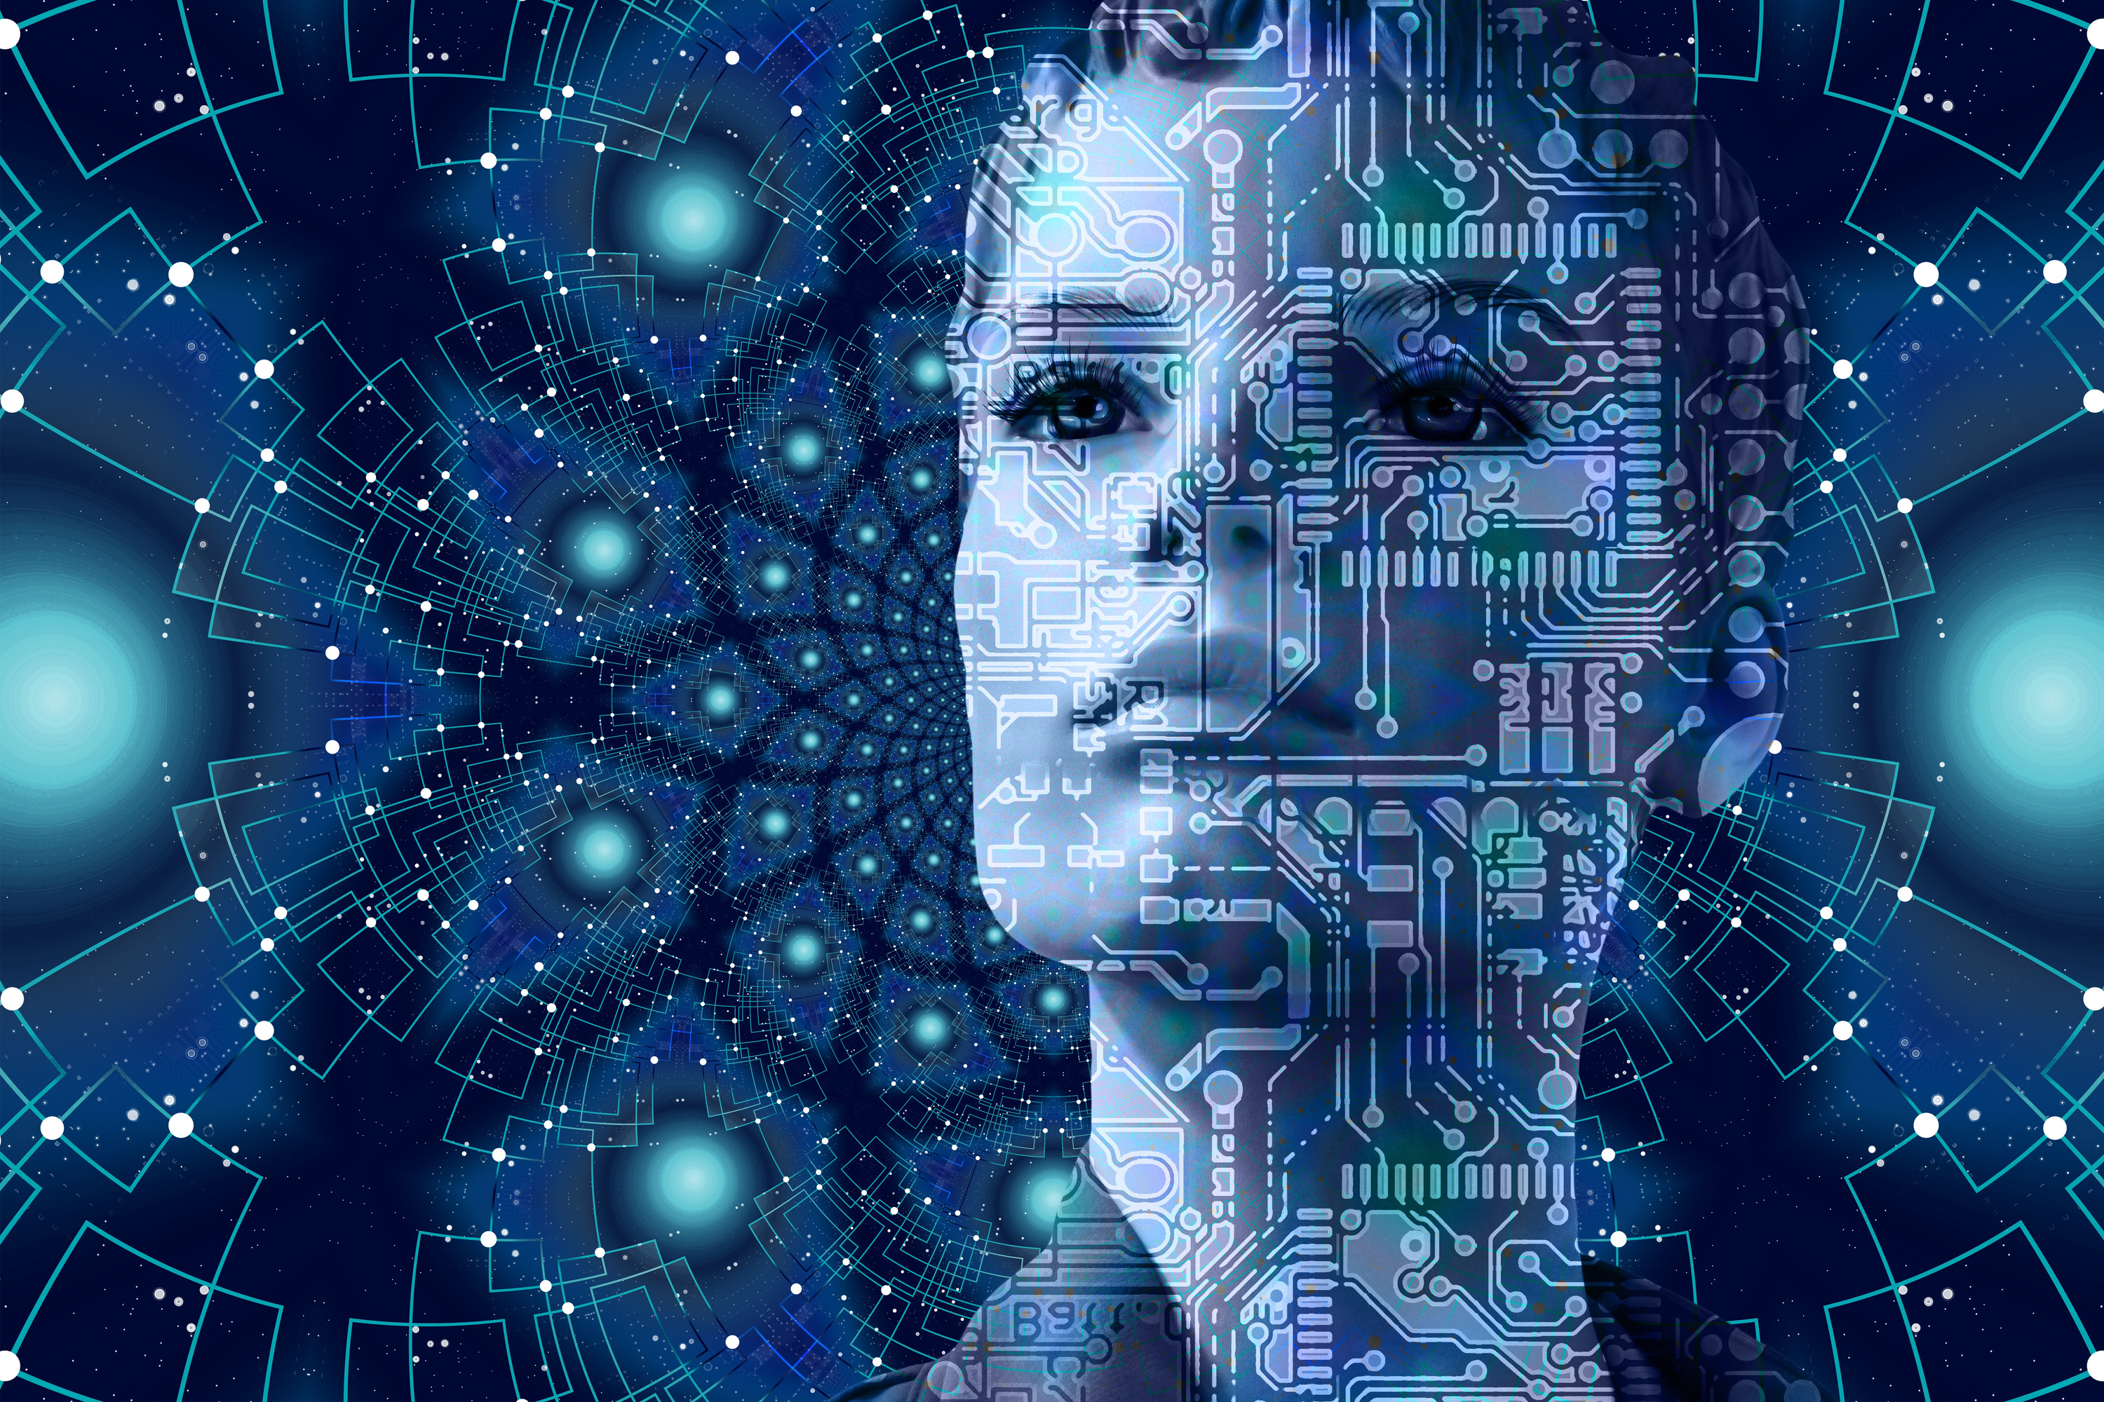

AI & EMERGING
TECHNOLOGIES

Slide 4



ABOUT ARTIFICIAL INTELLIGENCE
• AI IS THE BRANCH OF COMPUTER SCIENCE CONCERNED WITH THE STUDY AND CREATION OF COMPUTER SYSTEM THAT BEHAVE SOME FORM OF INTELLIGENCE
• IT IS THE SYSTEM THAT LEARN NEW CONCEPTS OF TASKS AND DRAW USEFUL CONCLUSION ABOUT THE WORLD.

Slide 5

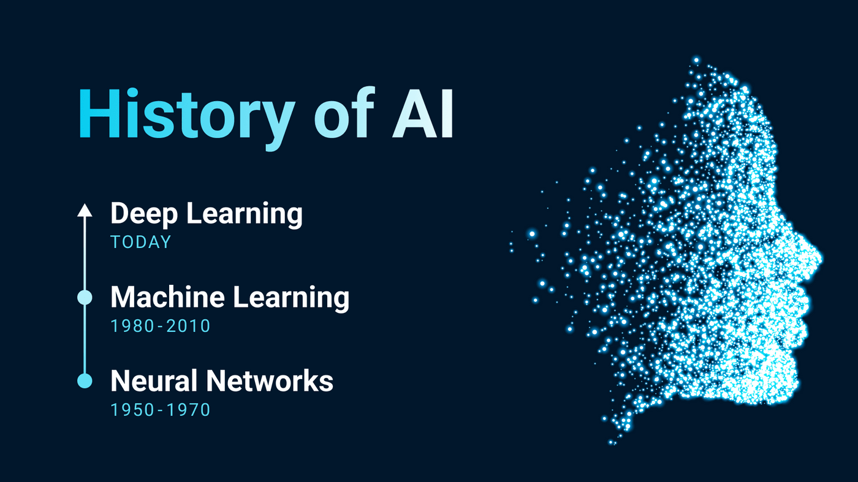

Slide 6





APPLICATIONS OF AI
HEALTHCARE :- Medical images analyses and decision support .
EDUCATION :- Personalized learning and Ai tutors .
AGRICULTRE :- Crop monitoring and smart farming .
INDUSTRY :- Automation and predictive maintenance .
TRANSPORT :- Traffic management and driver assistance system .
www.reallygreatsite.com

Slide 7

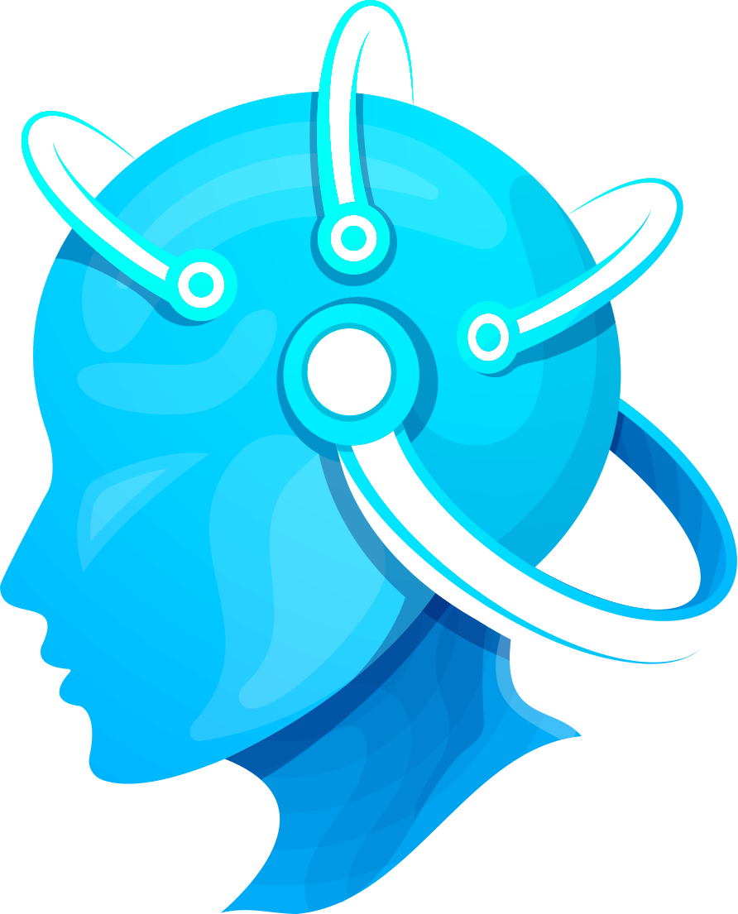
ADVANTAGES
Automation of repetitive tasks .
Faster data analysis and decision making .
Improved productivity .
New opportunity for innovation .
www.reallygreatsite.com

Slide 8



CHALLENGES
Privacy and data security .
Bias and fairness in Ai system .
Job roles may change because of automation .
High computing and implementation costs .
Need for responsible and ethical use .

Slide 9


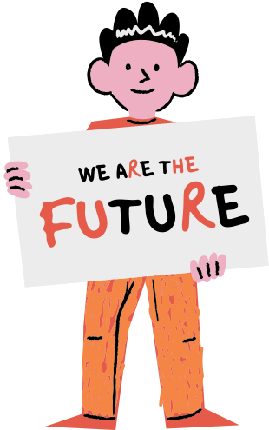

FUTURE SCOPE
Ai is excepted to become more integrated into everyday tools and services .
Emerging technologies will create new applications and career opportunities .
Human skills such as creativity , communications , critical thinking and ethical judgement will remain important .
www.reallygreatsite.com

Slide 10



CONCLUSION
Ai and emerging technologies are major drivers of digital transformation .
Their benefits depend on responsible developement and effective human oversight .
Learning Ai concepts and digital skills can help students prepare for the future .
www.reallygreatsite.com

Slide 11
THANK YOU.

